Slide 1
SYCL 2020
Inclusive heterogeneous computing with C++
Ronan Keryell
Khronos SYCL specification editor & Xilinx Research Labs (San José, California)
2021/04/26 oneAPI Developer Summit

Slide 2
Address the need for real inclusive programming standard
From embedded systems up to HPC and data-center systems
Complex systems with multiple devices from multiple vendors at the same time!
No performance compromise
Add your own devices on the picture!

Slide 3
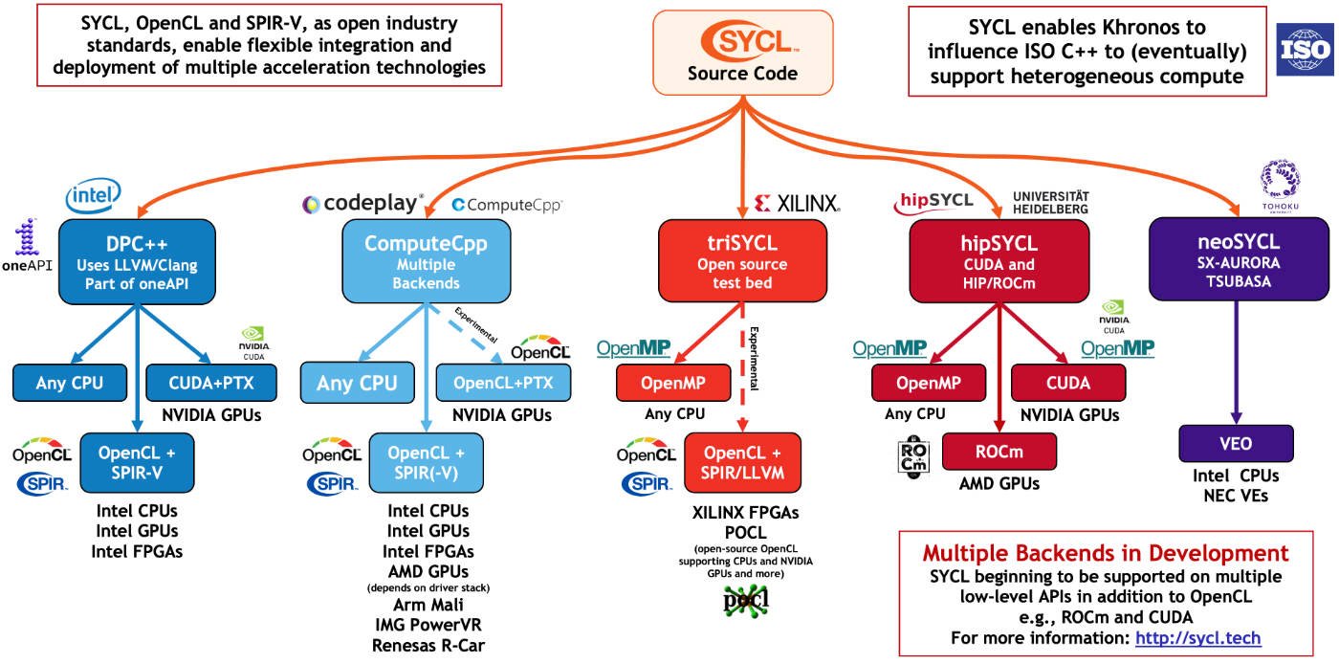
SYCL ecosystem is growing
+ Celerity: SYCL on MPI+SYCL
https://www.khronos.org/blog/sycl-2020-what-do-you-need-to-know

Slide 4
SYCL 2020 ≡ heterogeneous simplicity with C++17 and up
Abstract storage
#include <sycl/sycl.hpp>
#include <iostream>
using namespace sycl;
constexpr int N = 32;
int main () {
buffer<int> buf { N };
queue {}.submit([&](auto &h) {
accessor a { buf, h, write_only, no_init };
h.parallel_for(N, [=](auto i) { a[i] = i; });
});
for (host_accessor a { buf }; auto e : a)
std::cout << e << std::endl;
}
Code executed on device (“kernel”)
“Single-source”
  Seamless integration in host code
  Type-safety
Accessor
  Express access intention
  Implicit data flow graph
  Automatic data transfers across devices
  Overlap computation & communication

Slide 5
SYCL 2020 with unified shared memory (USM)
// Using buffers and accessors
#include <sycl/sycl.hpp>
#include <iostream>
using namespace sycl;
constexpr int N = 32;
int main () {
buffer<int> buf { N };
queue {}.submit([&](auto &h) {
accessor a { buf, h, write_only, no_init };
h.parallel_for(N, [=](auto i) { a[i] = i; });
});
for (host_accessor a { buf }; auto e : a)
std::cout << e << std::endl;
}
// Using USM only
#include <sycl/sycl.hpp>
#include <iostream>
using namespace sycl;
constexpr int N = 32;
int main () {
queue q;
int *a = malloc_shared<int>(N, q);
q.parallel_for(N, [=](auto i) { a[i] = i; });
q.wait();
for (int i = 0; i < N; i++)
std::cout << a[i] << std::endl;
}

Slide 6
SYCL 2020: reductions & group operations
buffer<int> valuesBuf { 1024 };
{
host_accessor a { valuesBuf };
std::iota(a.begin(), a.end(), 0);
}
int sumResult = 0;
buffer<int> sumBuf { &sumResult, 1 };
int maxResult = 0;buffer<int> maxBuf { &maxResult, 1 };
myQueue.submit([&](handler& cgh) {
auto inputValues = valuesBuf.get_access<access_mode::read>(cgh);
auto sumReduction = reduction(sumBuf, cgh, plus<>());
auto maxReduction = reduction(maxBuf, cgh, maximum<>());
cgh.parallel_for(range<1>{1024}, sumReduction, maxReduction,
[=](id<1> idx, auto& sum, auto& max) {
sum += inputValues[idx];
max.combine(inputValues[idx]);
});
});
assert(maxBuf.get_host_access()[0] == 1023 && sumBuf.get_host_access()[0] == 523776);

Slide 7
SYCL 2020: Multiple backends
Need to work with any framework
  Not only OpenCL like old SYCL
Need to control implementation details for maximum performance

Slide 8
Execution on Intel CPU + Xilinx FPGA (OpenCL) + Nvidia GPU (CUDA)
#include <iostream>
#include <sycl/sycl.hpp>
int main() {
sycl::buffer<int> v { 10 };
auto run = [&](auto sel, auto work) {
sycl::queue { sel }.submit([&](auto& h) {
auto a = sycl::accessor { v, h };
h.parallel_for(a.get_count(), [=](auto i) { work(i, a); });
});
};
run(sycl::host_selector {}, [](auto i, auto a) { a[i] = i; }); // CPU
run(sycl::accelerator_selector {}, [](auto i, auto a) { a[i] = 2*a[i]; }); // FPGA
run(sycl::gpu_selector {}, [](auto i, auto a) { a[i] = a[i] + 3; }); // GPU
sycl::host_accessor acc { v };
for (int i = 0; i != v.get_count(); ++i)
std::cout << acc[i] << ", ";
std::cout << std::endl;
}
clang++ -std=c++20 -fsycl -fsycl-targets=nvptx64-nvidia-cuda-sycldevice,fpga64_sw_emu FPGA_GPU_CPU.cpp -o FPGA_GPU_CPU
oneAPI DPC++ + triSYCL https://github.com/triSYCL/sycl
No template or typename or class or… ☺
Generic & type-safe
No explicit data motion or boiler-plate code

Slide 9
SYCL 2020 backend interoperability
Possible to build SYCL objects from native backend objects
    xrt::device d = open_Xilinx_VCK1500();
    xrt::bo xrt_bo = get_some_AIE_or_FPGA_storage(d);
    sycl::queue { sycl::make_device(d) }.submit([&](auto &cgh) {
    sycl::accessor acc { sycl::make_buffer(xrt_bo) };
    cgh.single_task([=] { /* some work on acc */ });
    });
  Allow integration of SYCL application into CUDA/OpenCL/L0/ROCm/Vulkan/XRT/ADF/AIR/…
  Kernel code can call directly native code and libraries, like Nvidia TensorCore…
Possible to get underlying native backend object from SYCL object
    sycl::buffer<int> buf { 1000 };
    auto xrt_bo = buf.get_native<sycl::backend::xrt>(buf);
    my_super_optimized_HLS_or_RTL_FPGA_function(xrt_bo);
  Allow direct integration of OpenCL/CUDA/L0/ROCm/Vulkan/XRT/… application into SYCL
  Obvious to use native optimized libraries

Slide 10
Documentation & resources
https://www.khronos.org/sycl
  The specification is open-source! https://github.com/KhronosGroup/SYCL-Docs
FAQ https://www.khronos.org/blog/sycl-2020-what-do-you-need-to-know
SYCL-related community resource web site http://sycl.tech

Slide 11
Conclusion
40+ new features with SYCL 2020
The most inclusive C++ standard for heterogeneous computing
  Any device from any vendor at the same time
Backends & extensions for maximum performance
  No transistor left behind!
  Leverage existing optimized libraries
Single-source C++ for simplicity and safety
Modern C++ but still plain C++
  Compatible with old C & C++
  Interoperable with usual embedded & HPC frameworks (Fortran!)
  Debug on CPU with usual software tools
Try it & get involved into the standard!

